Slide 1
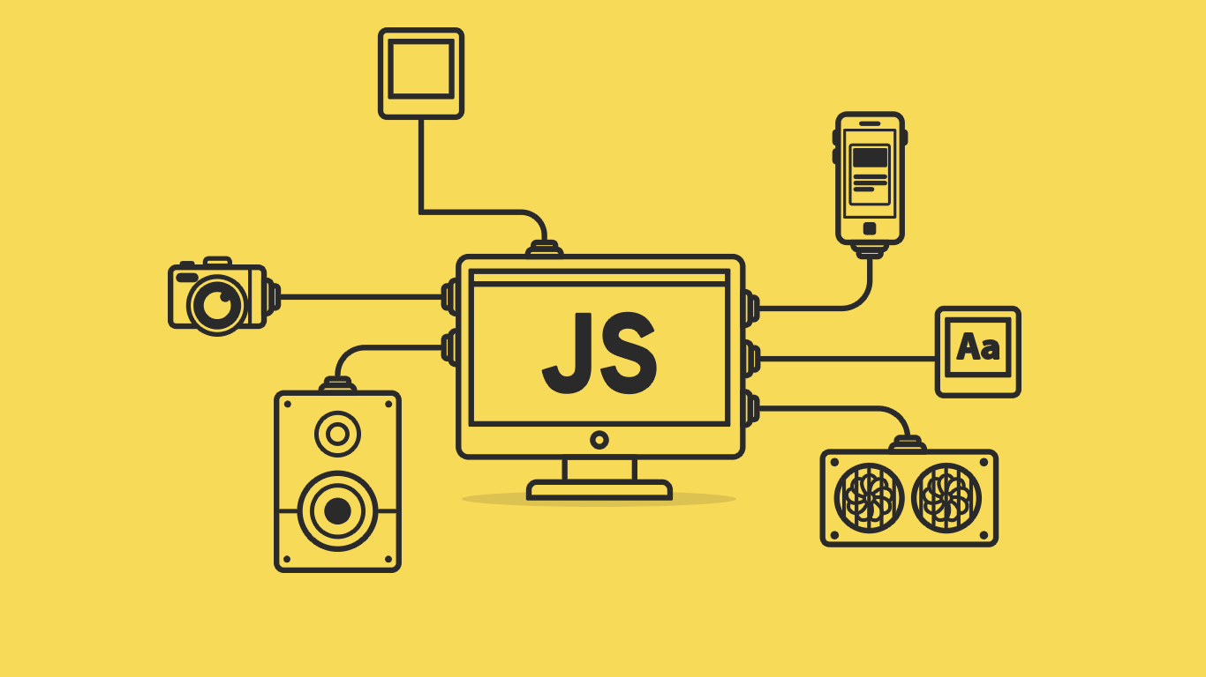

Slide 2
About today…
Objects
Intro
Creating
Accessing / Modification

Slide 4
Intro to JavaScript Objects
Definition
Objects are complex data structures in JavaScript used to store collections of
related data and functionalities
Key Points
Objects consist of key-value pairs
Keys are also called properties, and values can be any data type (e.g., strings, numbers, arrays, functions)
Example
{ name: 'John', age: 30, hobby: 'reading' }

Slide 5
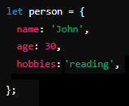
Creating Objects
Steps
Define an object using curly braces {}
Separate properties with commas
Example

Slide 6


Accessing Object Properties
Dot Notation
Bracket Notation

Slide 7


Adding and Modifying Properties
Adding property
Modifying property

Slide 8


Slide 9

What are objects used for in JavaScript?
How are properties accessed in an object using dot notation?
Which is a valid way to add a new property to an object?

Slide 10

Task 1
Create an object called car with properties for brand, year, and color. Display these properties using dot and bracket notation. Add a new property for the car's model, and modify the year property. Display the modified year property
Task 2
Create an object named person with properties for name, age, and hobby. Display these properties using both dot and bracket notation. Add a new property for the person's gender and modify the age property. Display the modified age property

